Slide 1

How to make folders - os.mkdir vs os.makedirs

Slide 2
Reference
Youtube
Code

Slide 3
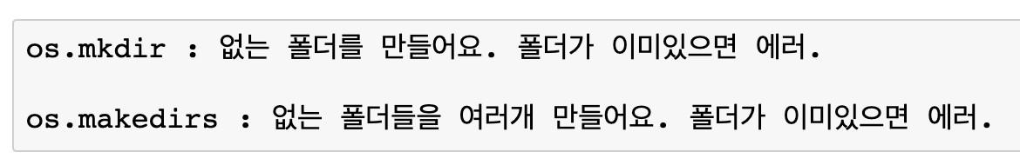
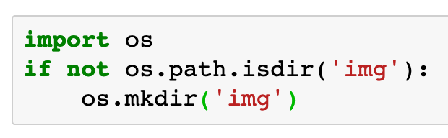

Slide 4
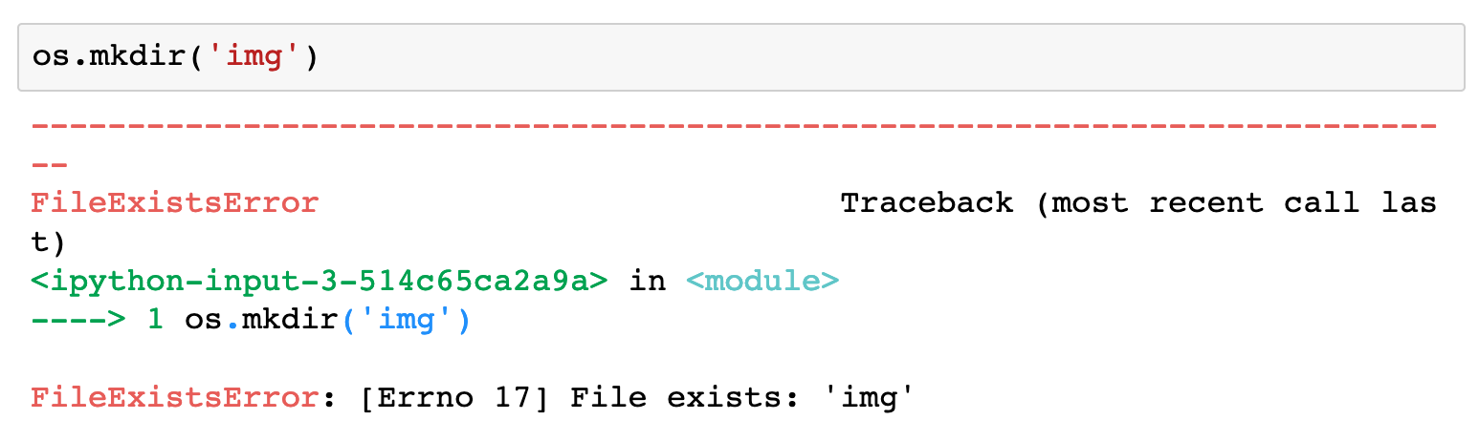

Slide 5
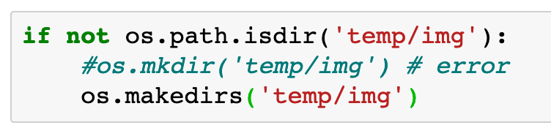

Slide 6
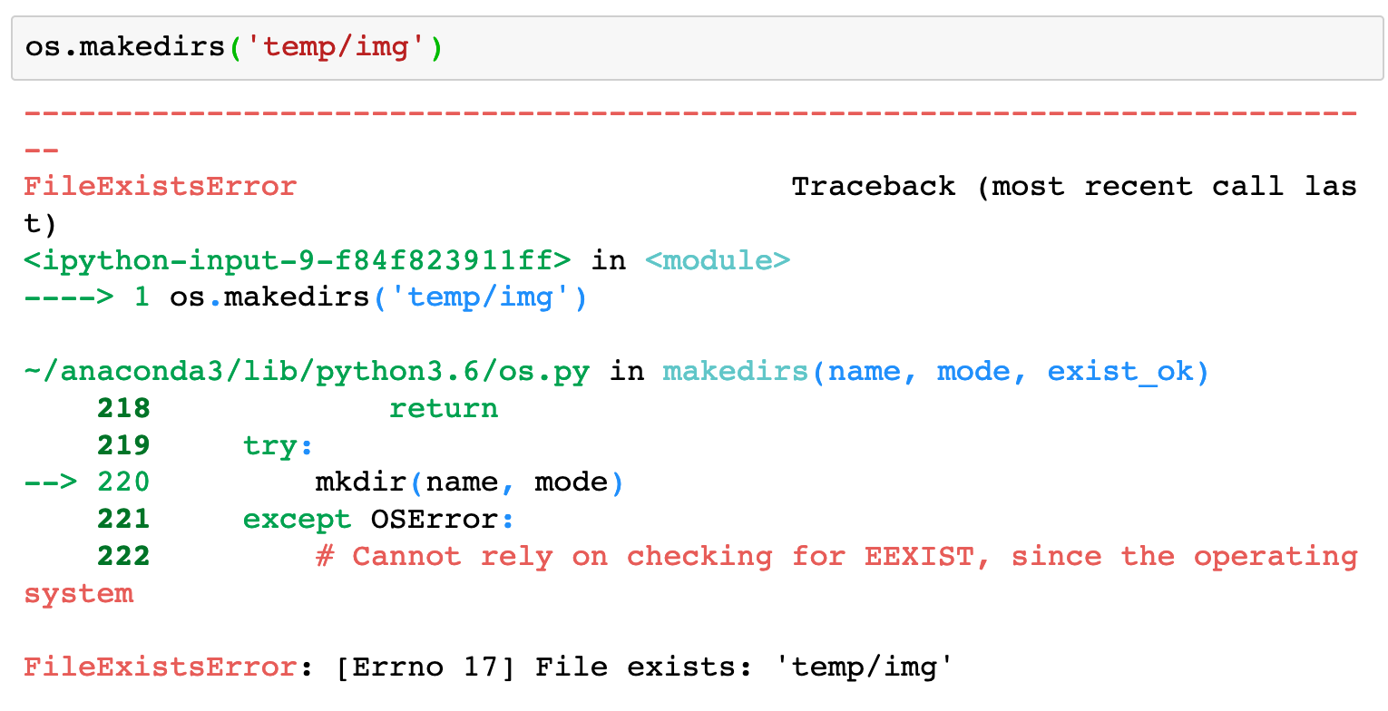

Slide 7
Now
Let’s Play with Code

